Slide 1

Bradford Hull
Lifespan Analysis of Worms
Consultation: September 12th, 2024
STAT688 | Huashi Li, Alex Salce (Taryn Laird)

Slide 2
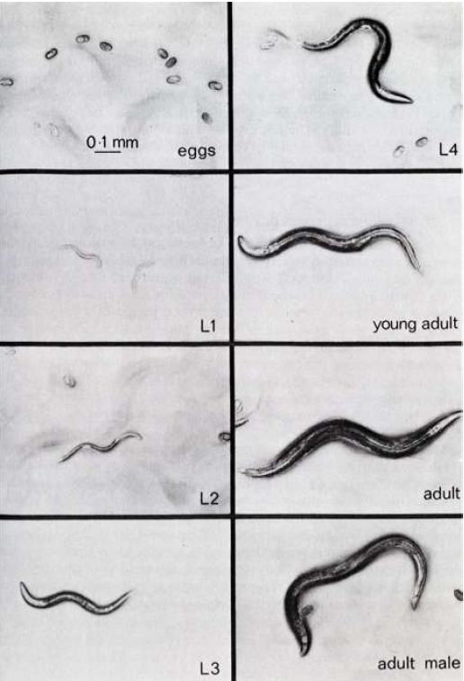
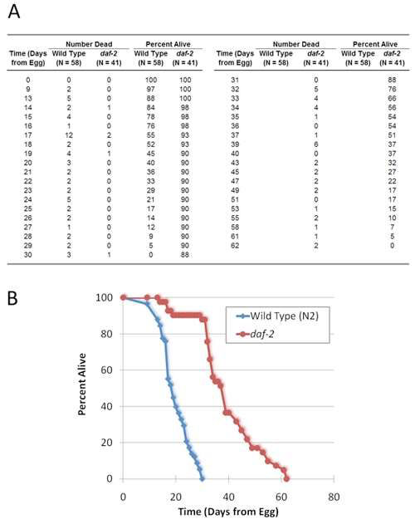
Background
Client: Bradford Hull
5th year PhD student in MCB
Studying aging in worms
Lifespan data & K-M curve from provided example paper
Sutphin GL, Kaeberlein M. Measuring Caenorhabditis elegans life span on solid media. J Vis Exp. 2009 May 12;(27):1152. doi: 10.3791/1152. PMID: 19488025; PMCID: PMC2794294.
Summary of the Problem
Bradford wants to compare lifespans of worms that are all drawn from the same batch of eggs placed in different media
Agar culture (individual plates)
~40 worms per plate
Liquid culture (reservoir)
~5000 worms per reservoir
Treatments are “stressors” added to each media, and he wants to evaluate the effects of stressors in each media on worm lifespans
He has collected data and wants to perform statistical analyses of the effects of treatments both within media as well as between media to determine if different.
There were differences between how he was able to capture lifespan data between the liquid and agar media due to some measurement challenges.
His primary concerns were whether the experimental procedures were adequate to carry out his intended analyses.
Prefers Kaplan-Meier if feasible with the data he captured
Experimental Units

Slide 3




Treatments (stressors)
Control (no stressor)
Copper
DTT (dithiothreitol)
Exp Units
Exp Units
N~40
N~40
N~40
N~40
N~40
N~40
N~5000
N~5000
N~5000
N~40
N~40
N~40
Media: Liquid culture (reservoirs)
Media: Agar culture (plates)
Experiment
Additional Information
Experimental units were made using eggs from the same batch/population, started at same time
Data is recorded every two days for all experimental units
Agar – raw number of alive remaining are recorded
Liquid - ~150mL sampled from each and number of alive/dead recorded (sample is discarded, i.e. sampling without replacement.
Three replicates are performed per experimental unit per timestep (matches number Agar replicates)
Number of worms per experimental unit & number of replicates determined by a power analysis in MCB for this type of experiment.
The R package `survival` was used for analysis of Agar data

Slide 4
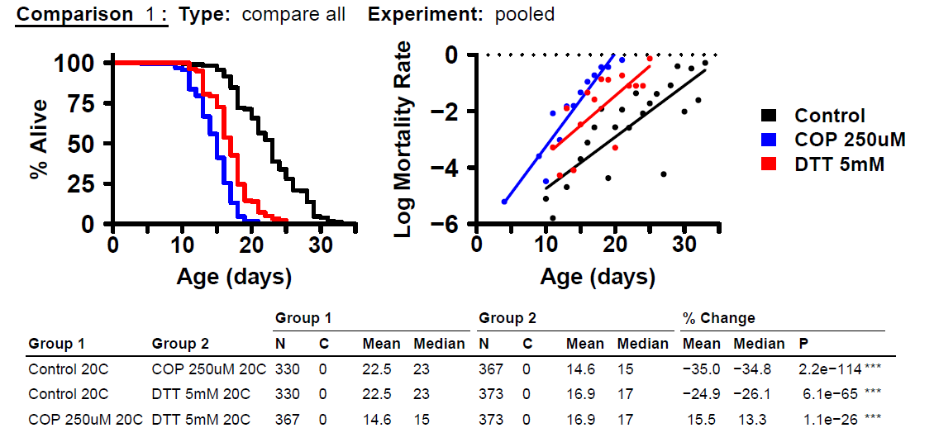
Between Media Comparisons
Between Treatment Comparisons (within media)
Agar treatment comparisons have already been performed
Consultant Next Steps
Determine if data that has been captured can be applied to the Kaplan-Meier statistical analysis framework to perform these comparisons
Can we recommend K-M, and if we cannot then what is our recommendation?
Based on our analysis of the provided data and experimental procedure details
Agar media data are suitable for K-M
Liquid media data are not suitable for K-M
Next steps
Determine if/how there is an adequate statistical approach to analyze liquid lifespan data
If so, can we do all of desired comparisons?

